Slide 1
Drug Adherence Regression Test

Slide 2
Scenario
7 Nodes
1000 people per node
No Migration
Zero Vectors
Drug Parameters
"PKPD_Model": "CONCENTRATION_VERSUS_TIME",
"Malaria_Drug_Params": {
"TestDrug": {
"Bodyweight_Exponent": 0,
"Drug_Cmax": 1000,
"Drug_Decay_T1": 1,
"Drug_Decay_T2": 4,
"Drug_Dose_Interval": 5,
"Drug_Fulltreatment_Doses": 4,
"Drug_Gametocyte02_Killrate": 0,
"Drug_Gametocyte34_Killrate": 0,
"Drug_GametocyteM_Killrate": 0,
"Drug_Hepatocyte_Killrate": 0,
"Drug_PKPD_C50": 500,
"Drug_Vd": 3,
"Max_Drug_IRBC_Kill": 3.45
}
}
Fast decay
Normal 20 day regimen

Slide 3
Campaign
All nodes, Day 10, Outbreak
Node 1, No drugs
Node 2, Day 30, AntimalarialDrug
Node 3, Day 30, AdherentDrug, STOP
Node 4, Day 30, AdherentDrug, LOST_TAKE_NEXT
Node 5, Day 30, AdherentDrug, NEXT_DOSAGE_TIME
Node 6, Day 30, AdherentDrug, NEXT_UPDATE
Node 7, Day 30, AdherentDrug, Combination
Adherence
Nodes 3-6 - 10% chance to take each dose
Node 7 – Dose and Age dependent
The action the person takes if they do not take a particular dose.

Slide 4
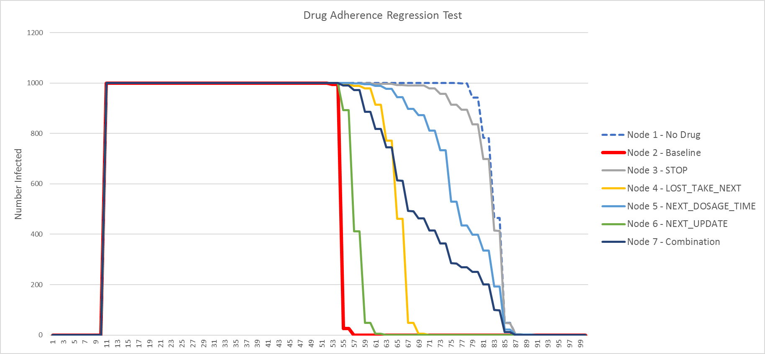
Number Infected Per Node

